Slide 1

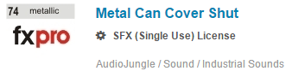
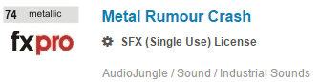
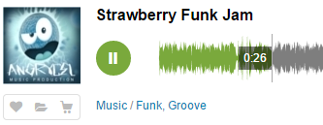
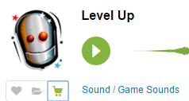
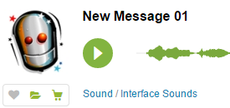
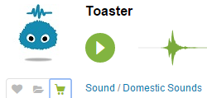
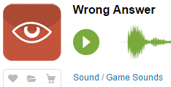
Sounds
Title Screen
Button Click
Flip Award Screen
Background
Slide 7
Slide 13
Land in Can
Incorrect

Slide 2
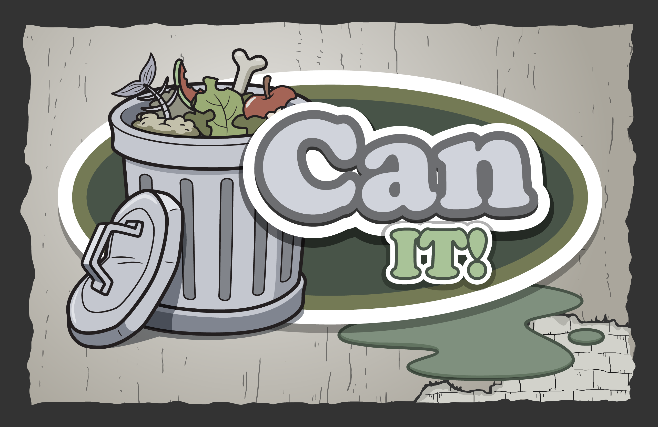


Slide 3
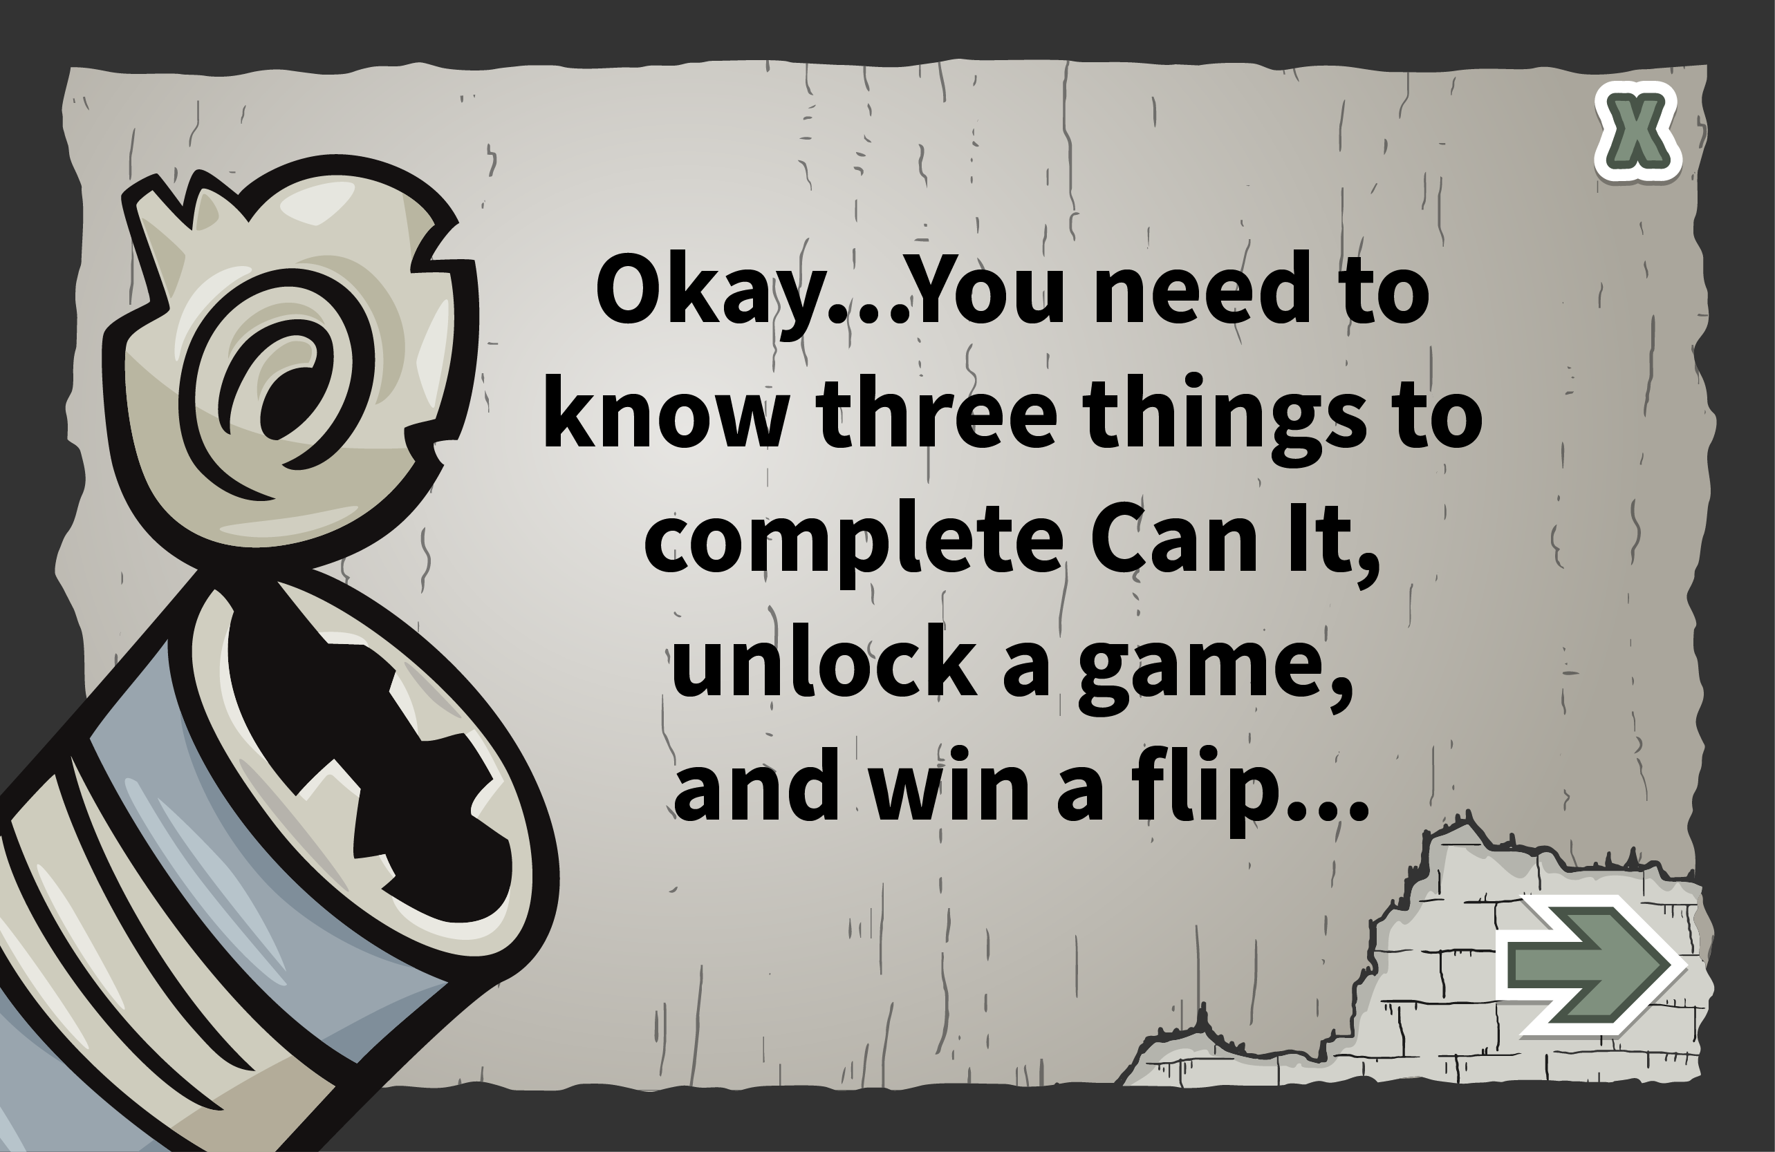

Slide 4
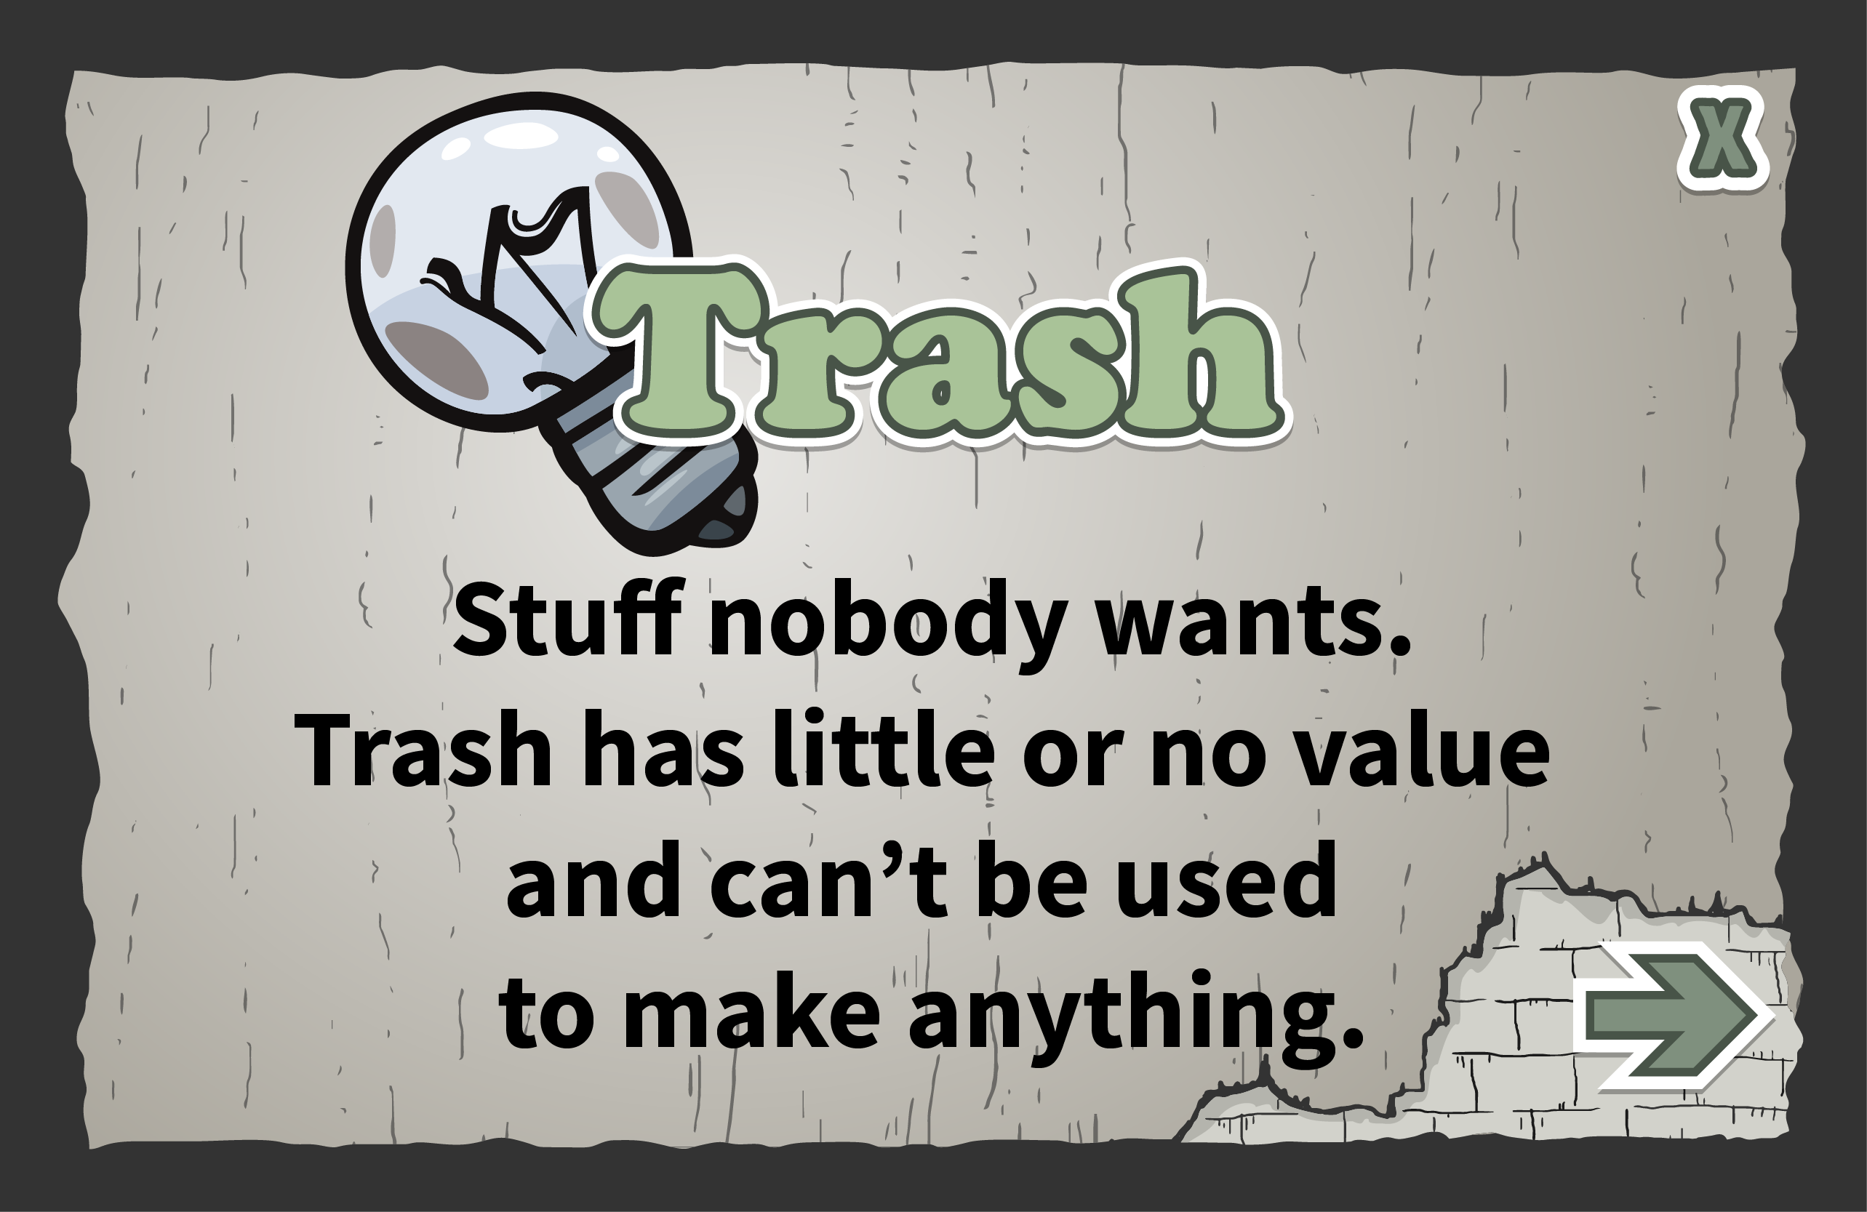

Slide 5
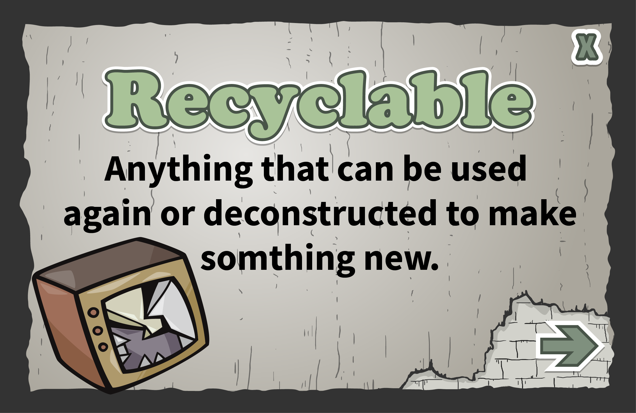

Slide 6
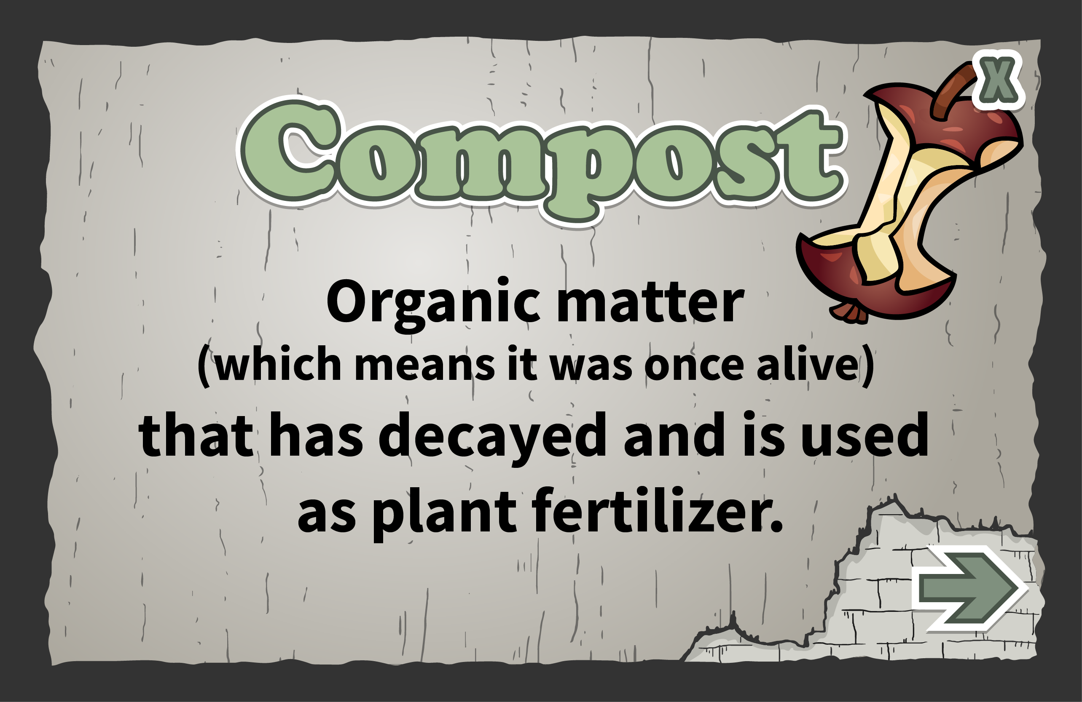

Slide 7
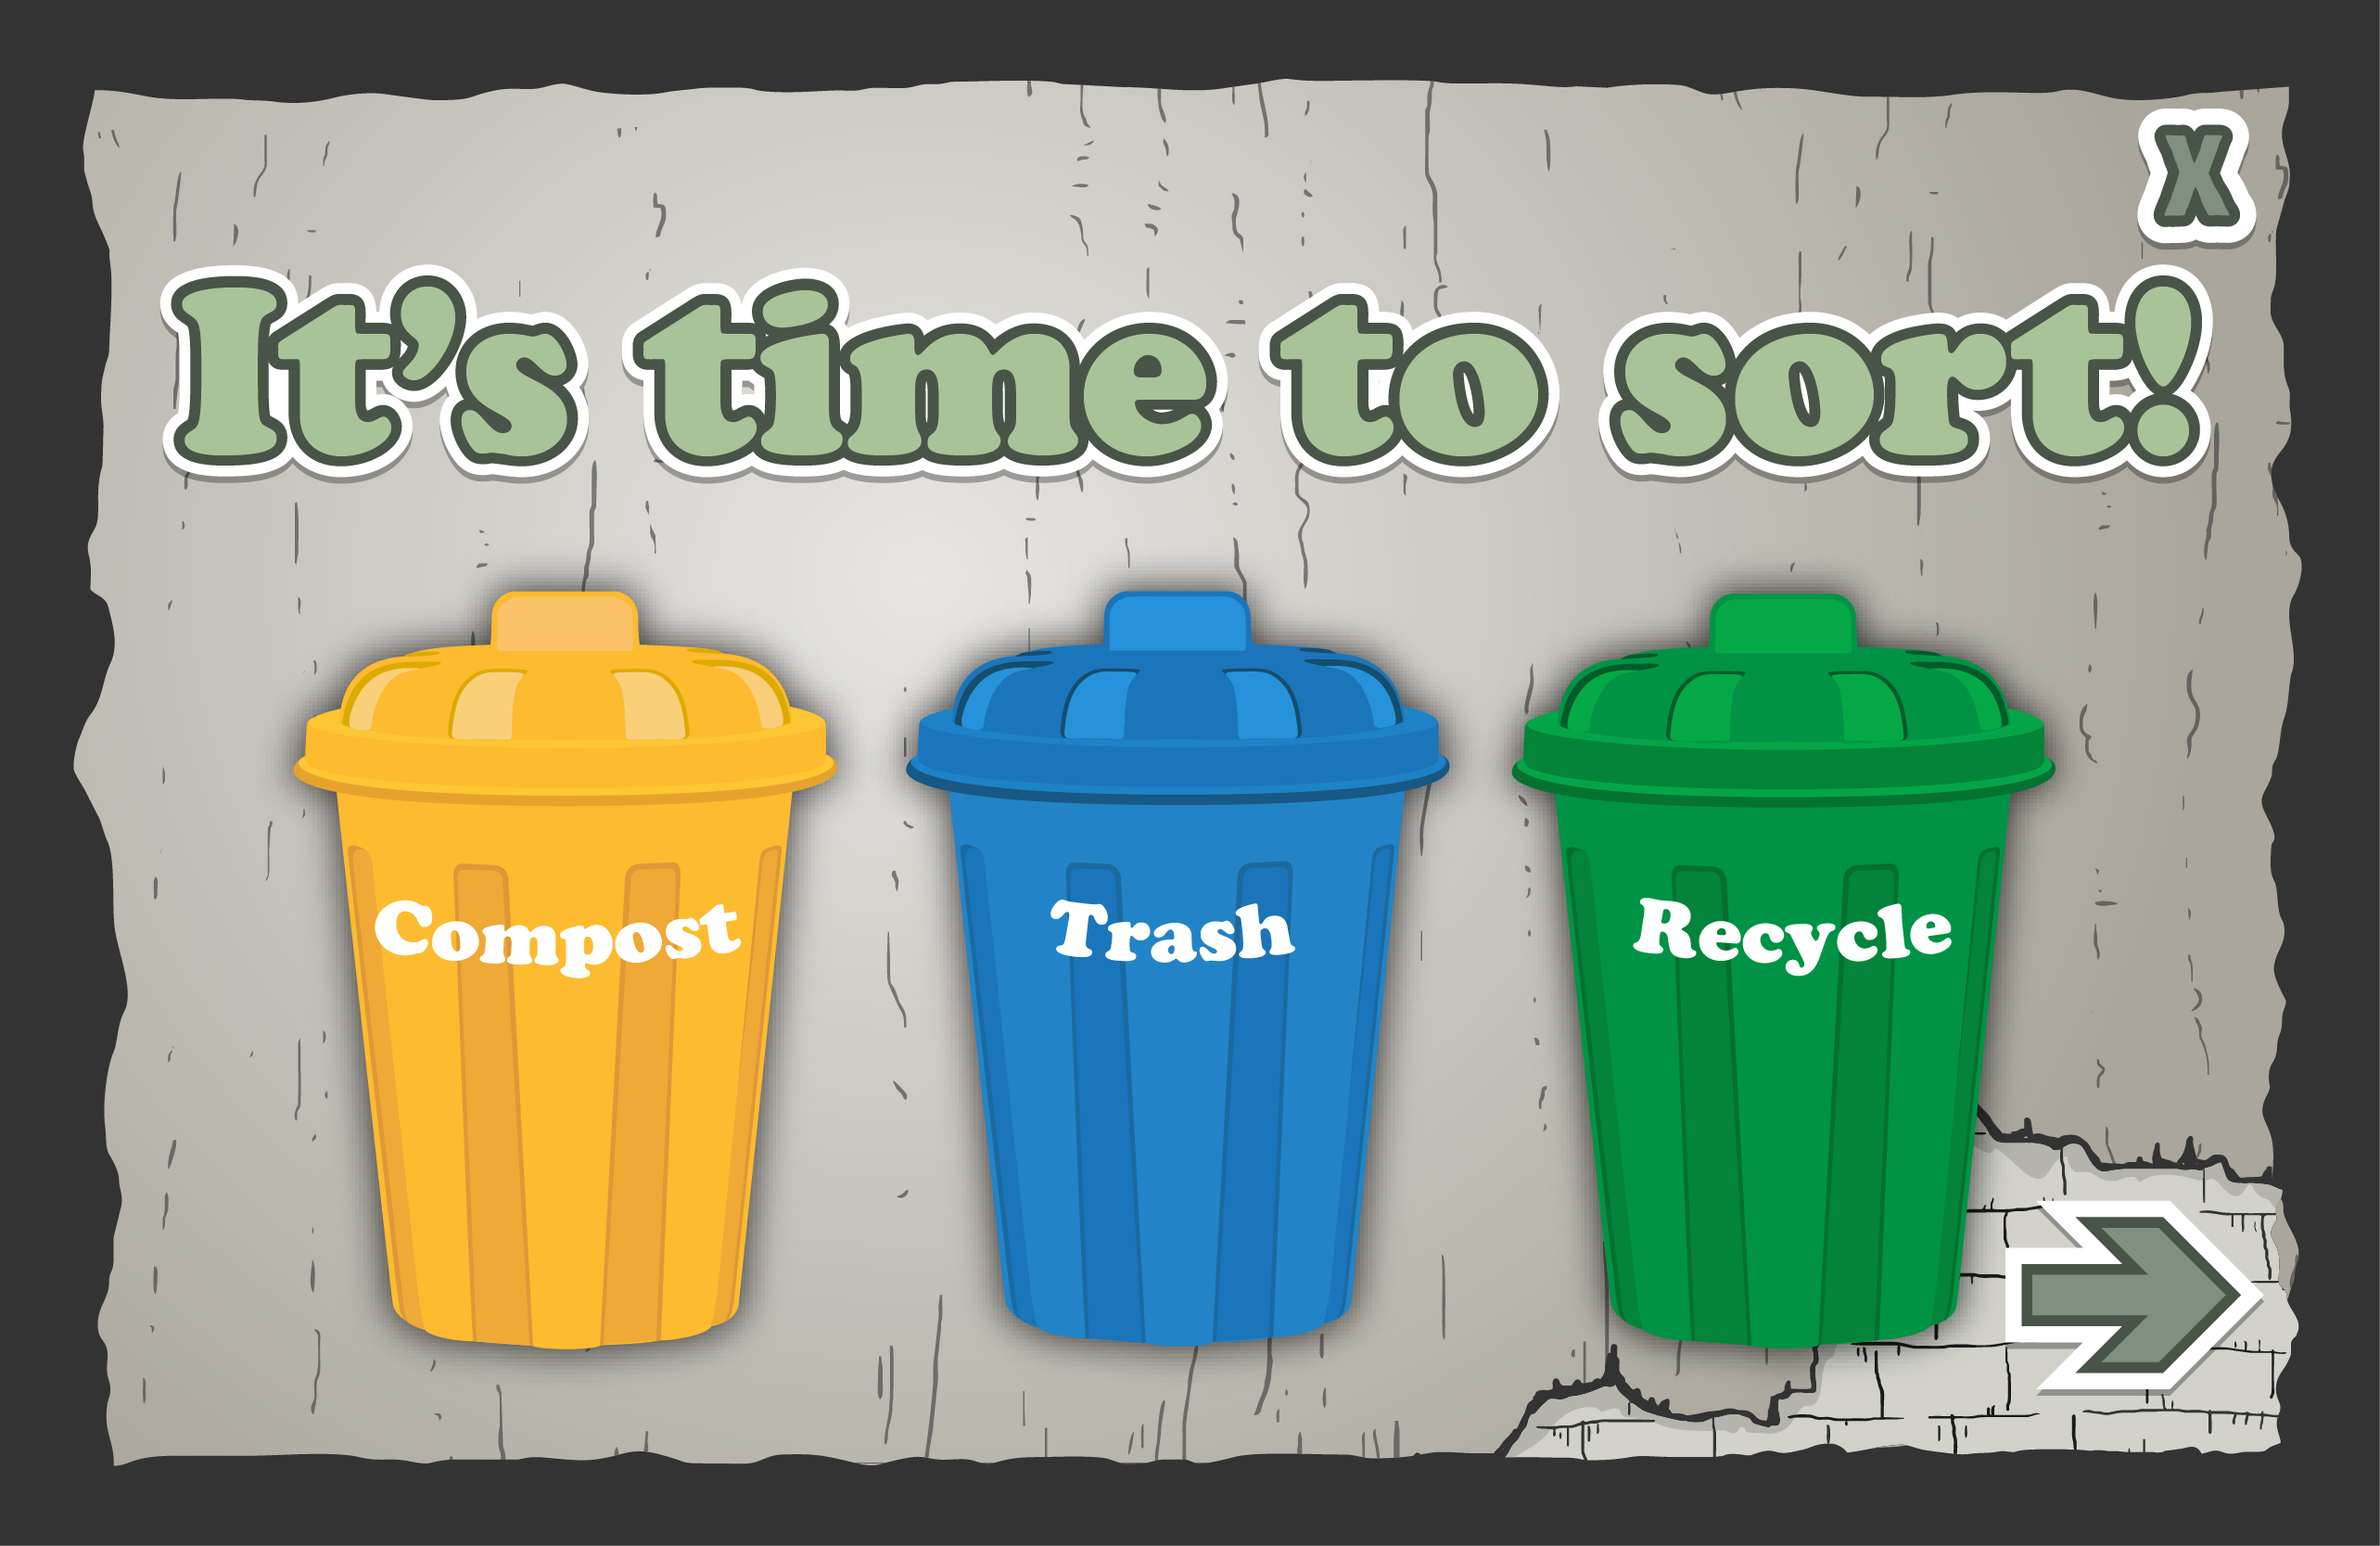

Slide 8
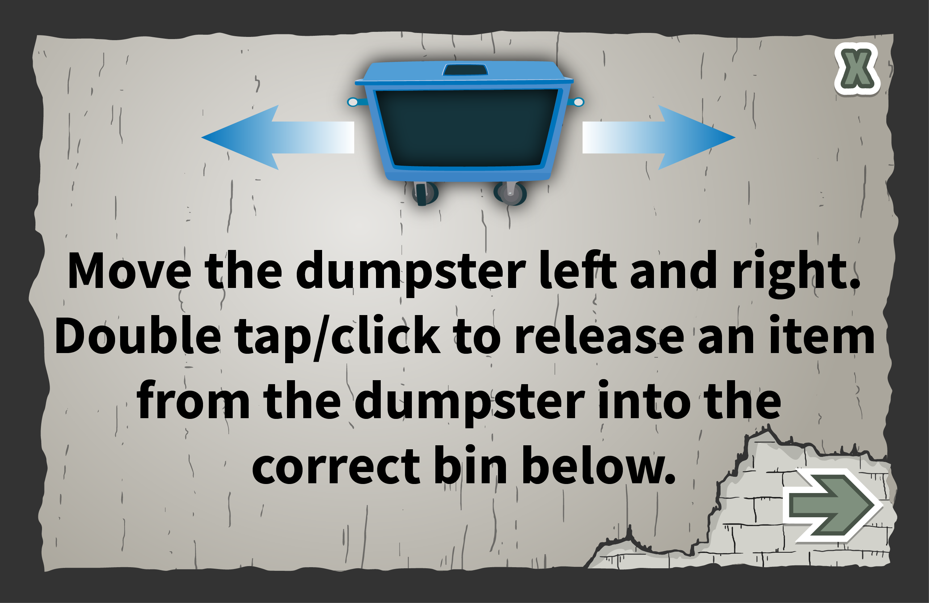

Slide 9
Transition to unity platform

Slide 10
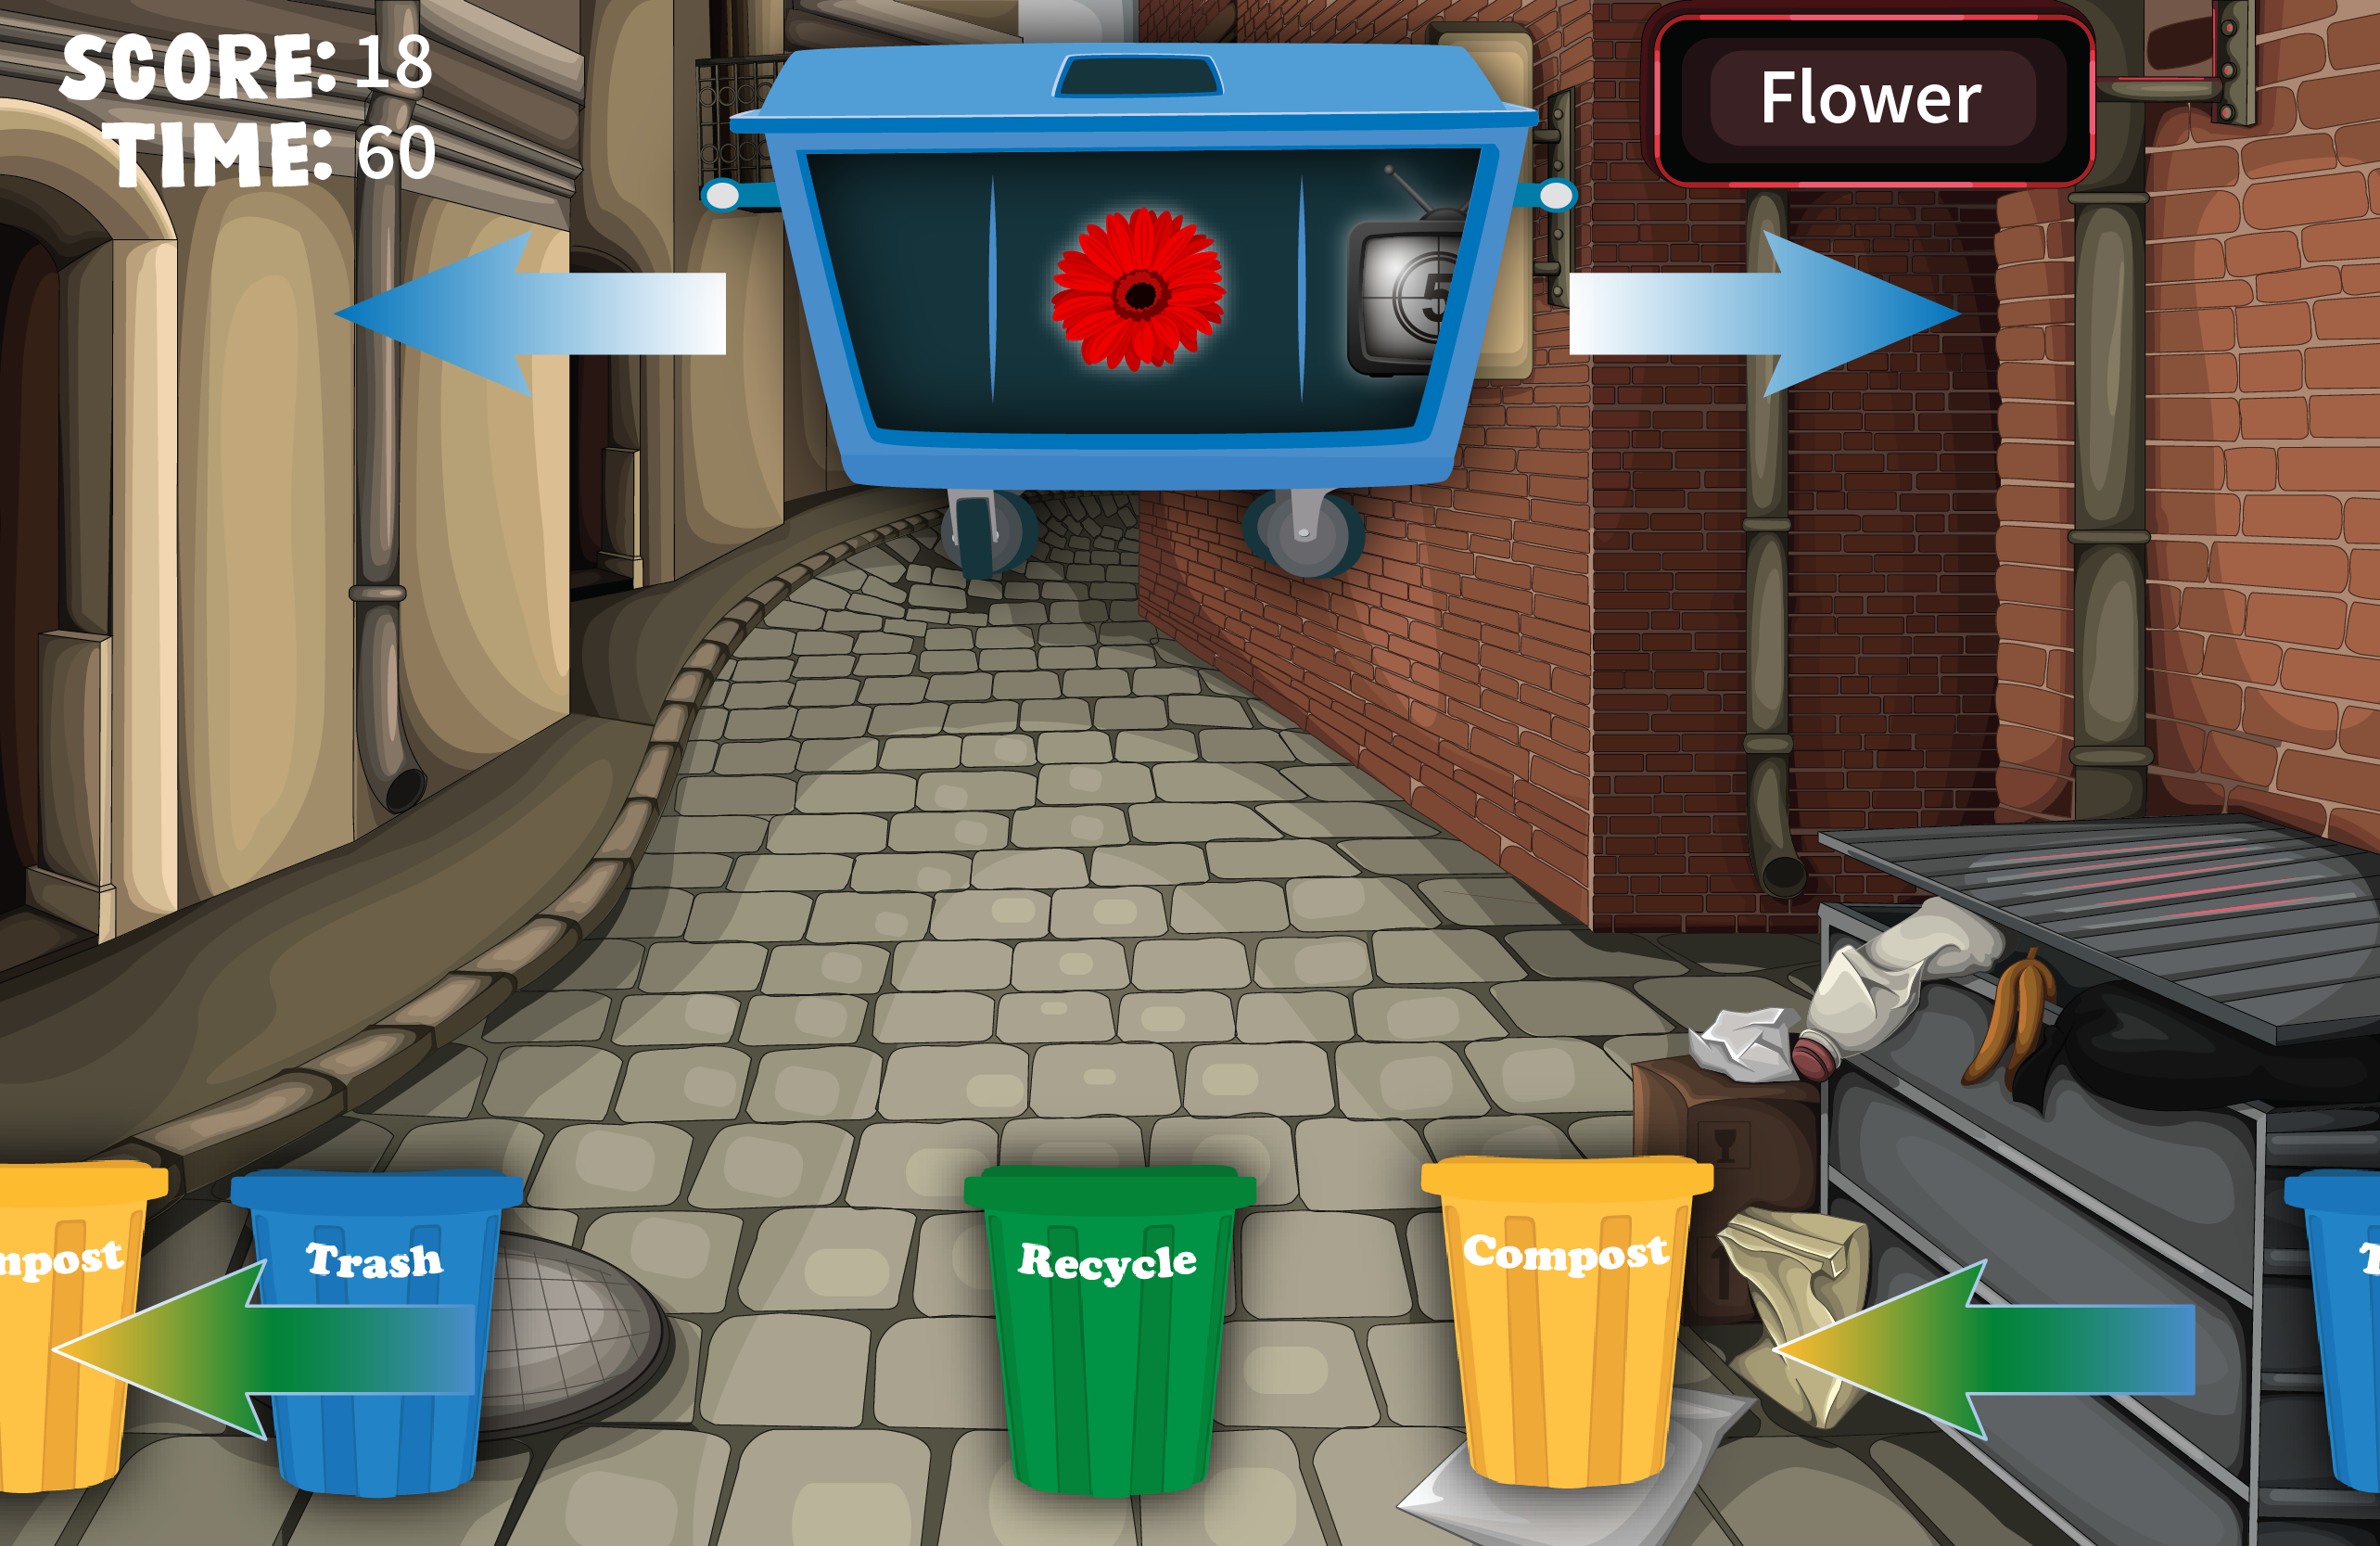
Dev-
Arrows flash on dumpsters a few times and then disappear
And then the arrows flash on the trash can row below and then disappear
Name of item appears on the sign
The row of trash cans should be mixed and grouped and single, can be a repeating order/pattern
Each Item that is dropped in to the correct bin is 15 points.
There is only one level
User plays for 90 seconds, and has the option to play again.
If an item in added to the wrong trash can you get a incorrect sound and loose 30 pts,
*** user can have a neg number of points
User moves the dumpster left and right, with mouse or finger. Double tap/click releases the item from the dumpster.
Sound for landing in the can

Slide 11
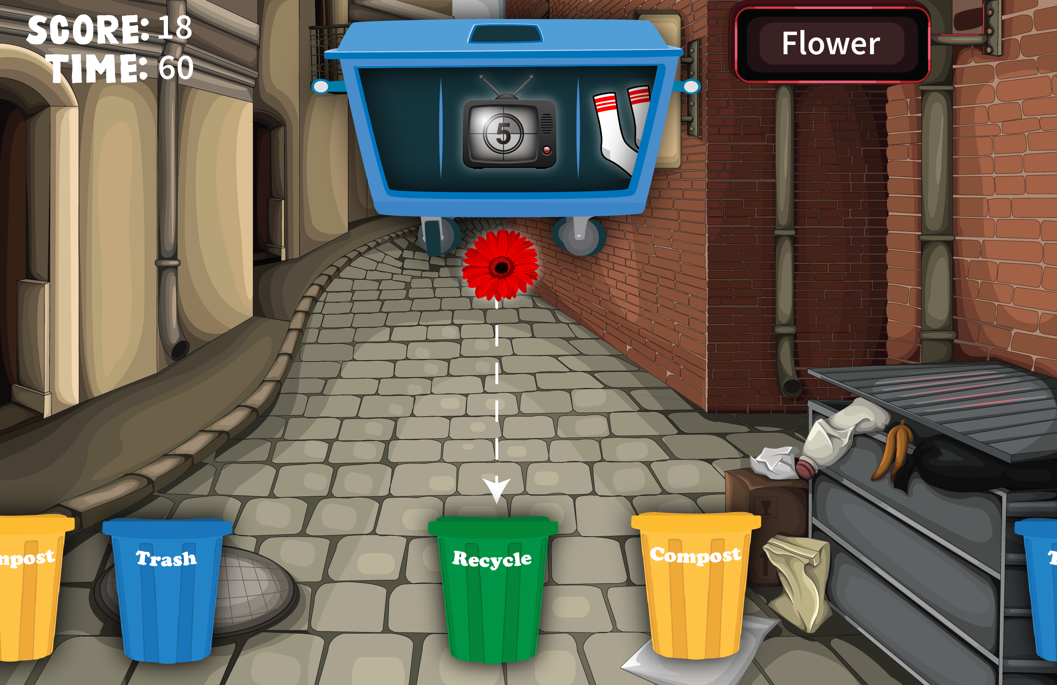
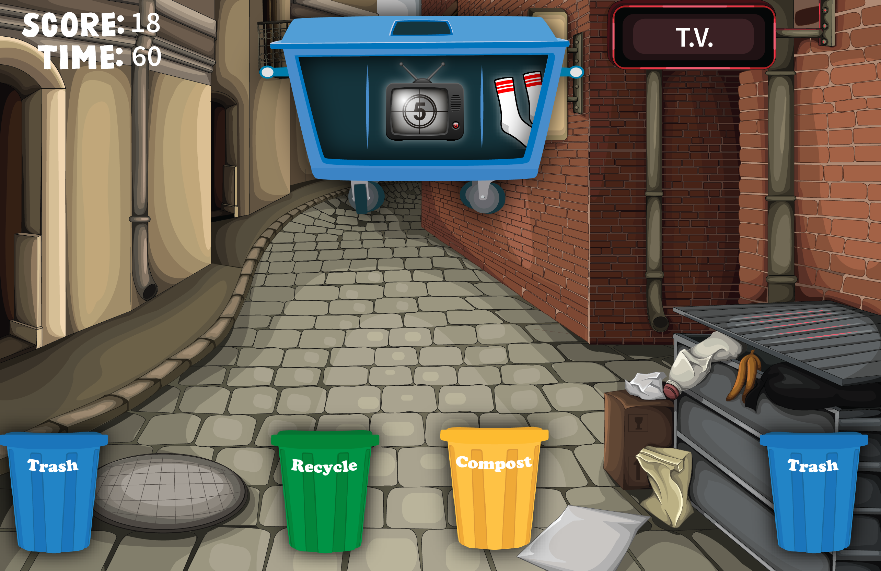
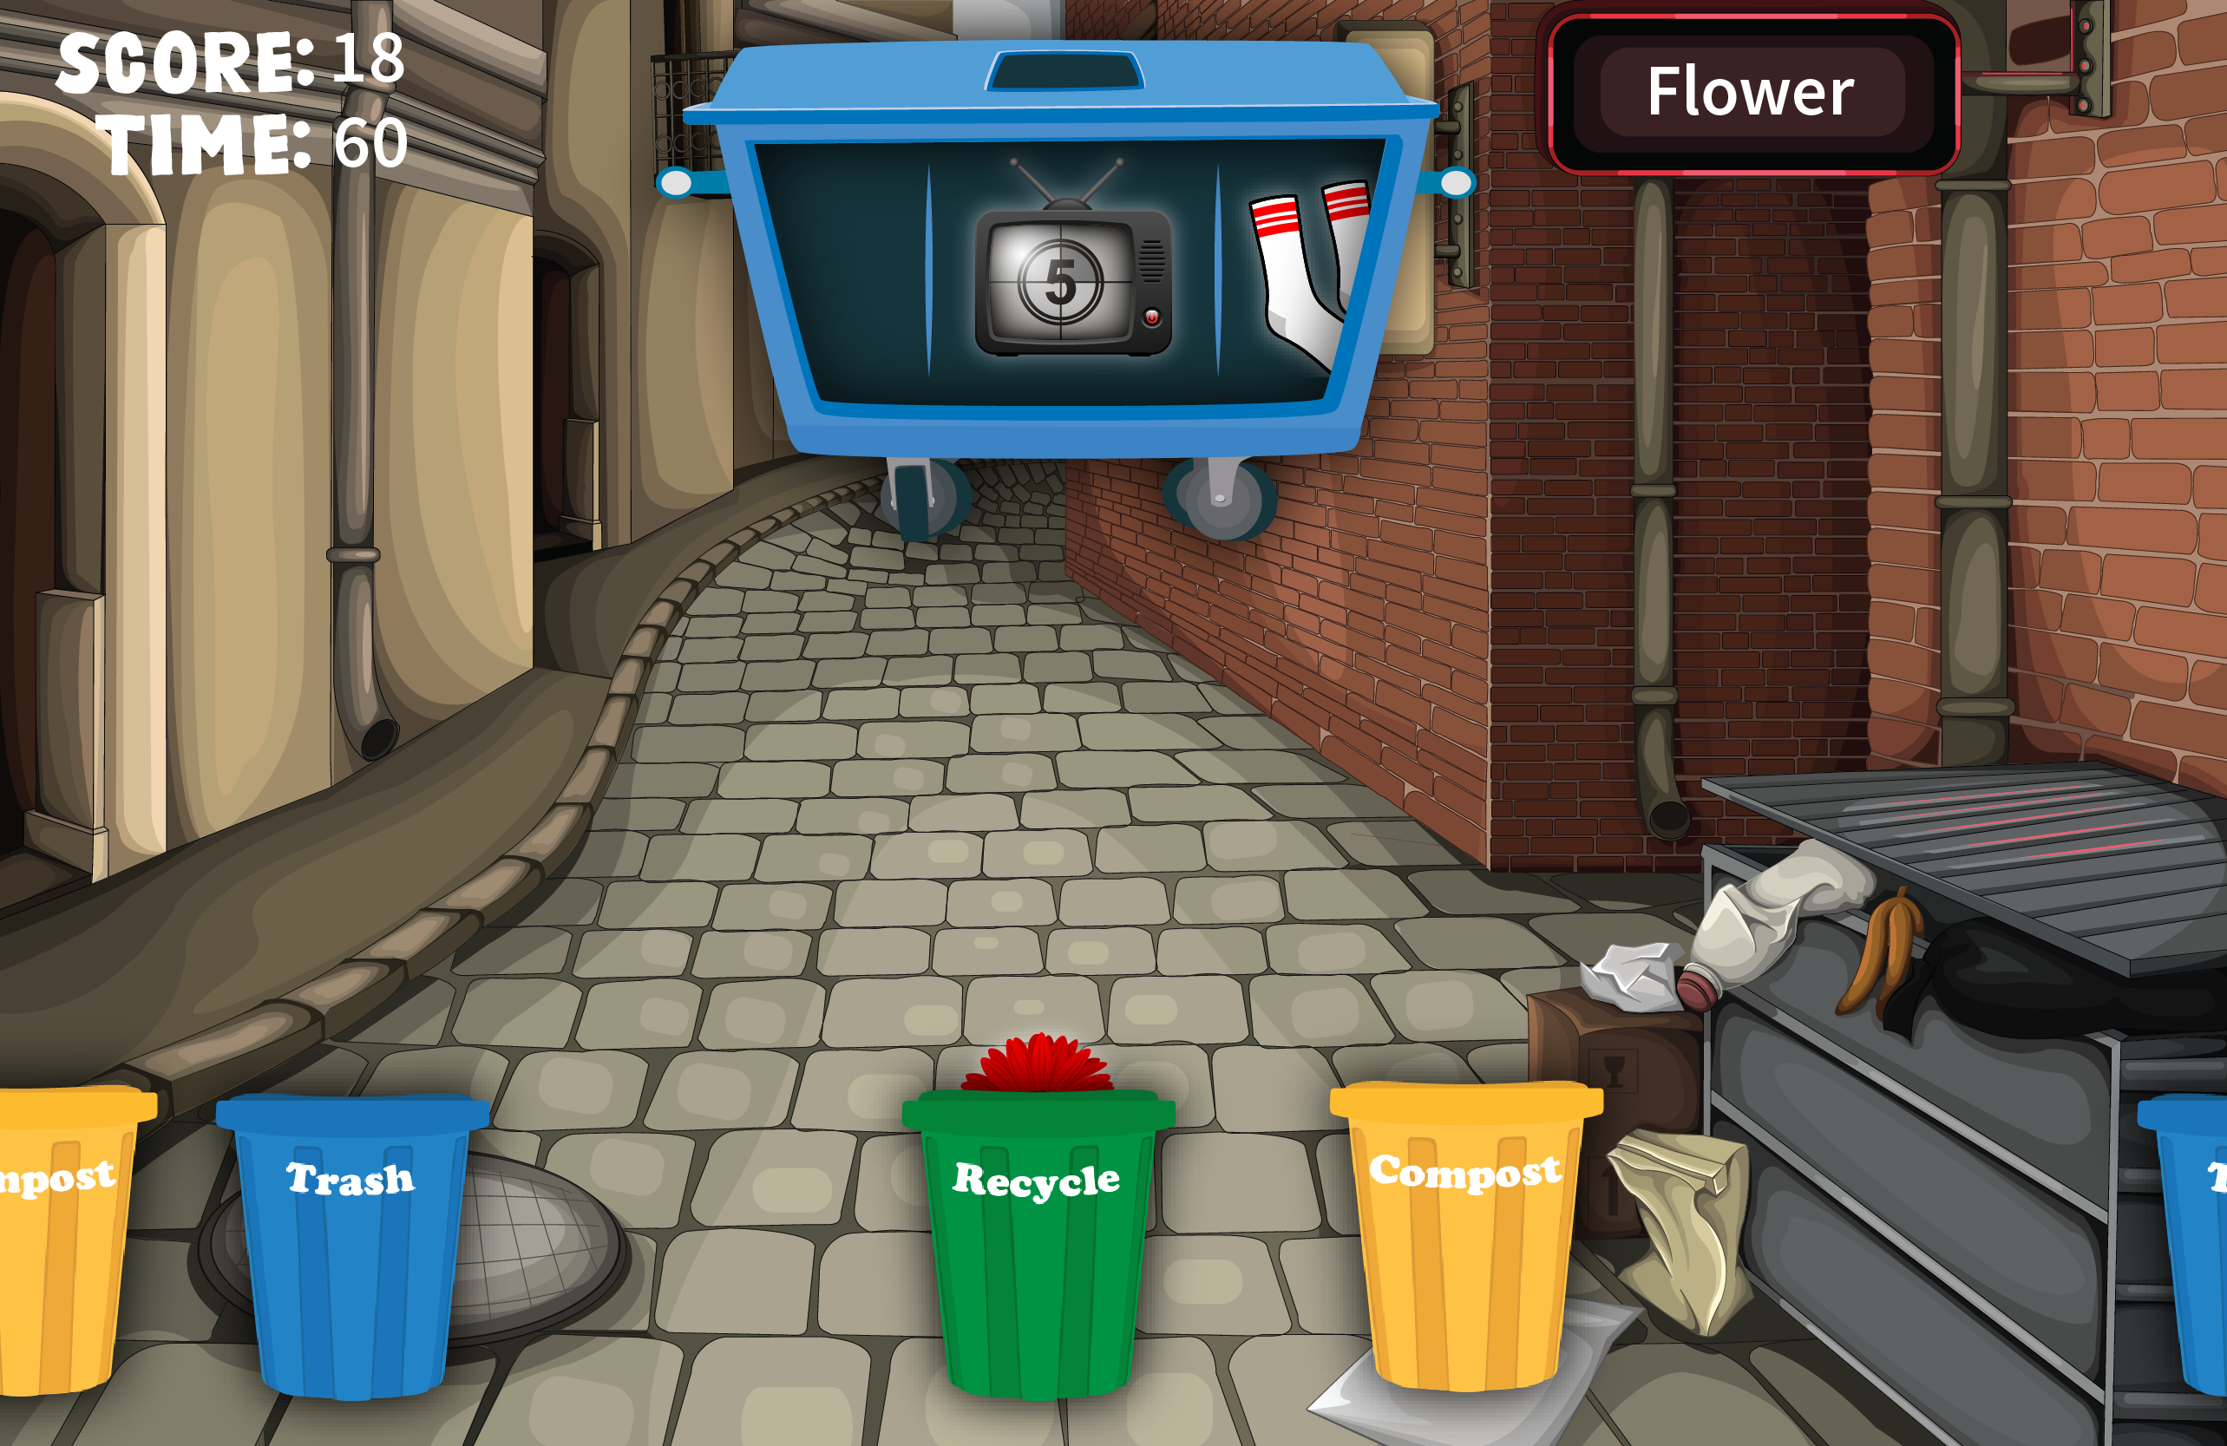
1
3
2

Slide 12
This is a list of items to be used both in the trash can sorting and for the game that follows. We will use 5 of each for the trash can sorting and as many as needed for the game.
Recyclable:
Soda Bottle
Soda Can
TV
Computer
Newspaper
Cardboard Box
Magazine
Soap bottle
Milk Carton
Books
Tissue Box
Cell Phone
Plastic Tray
Plastic Bag
Water Bottle
Metal Can
Paper Carton
Plastic package
Compost:
Banana peel
Apple Core
Carrot
Tea Bag
Saltine Cracker
Egg Shells
Peanut shells
Flowers
A Leaf
Straw or Hay
Piece of toast
A feather
Oatmeal
Trash:
Mirror
Incandescent Light Bulb
Old sock
Paint Can
Oil Can
Diapers
Batteries
Styrofoam

Slide 13
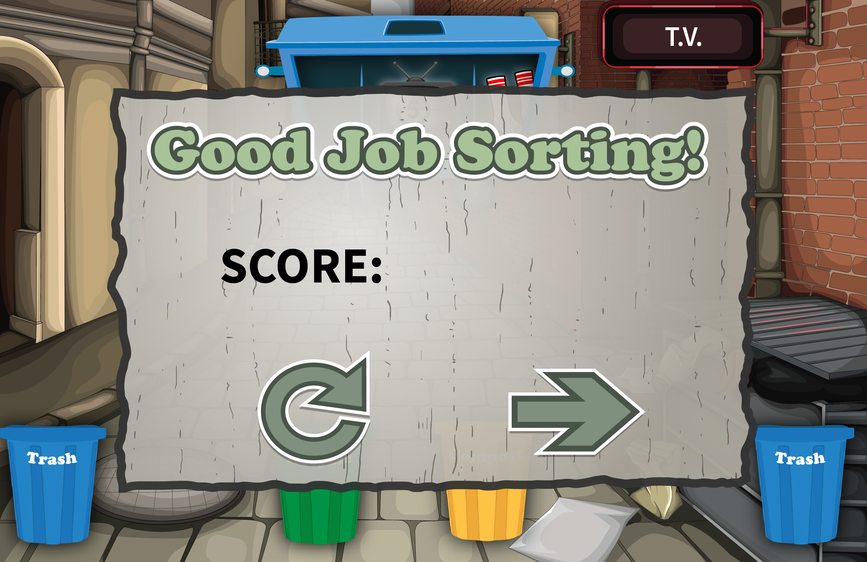

Slide 14
Transition to CMWN application

Slide 15
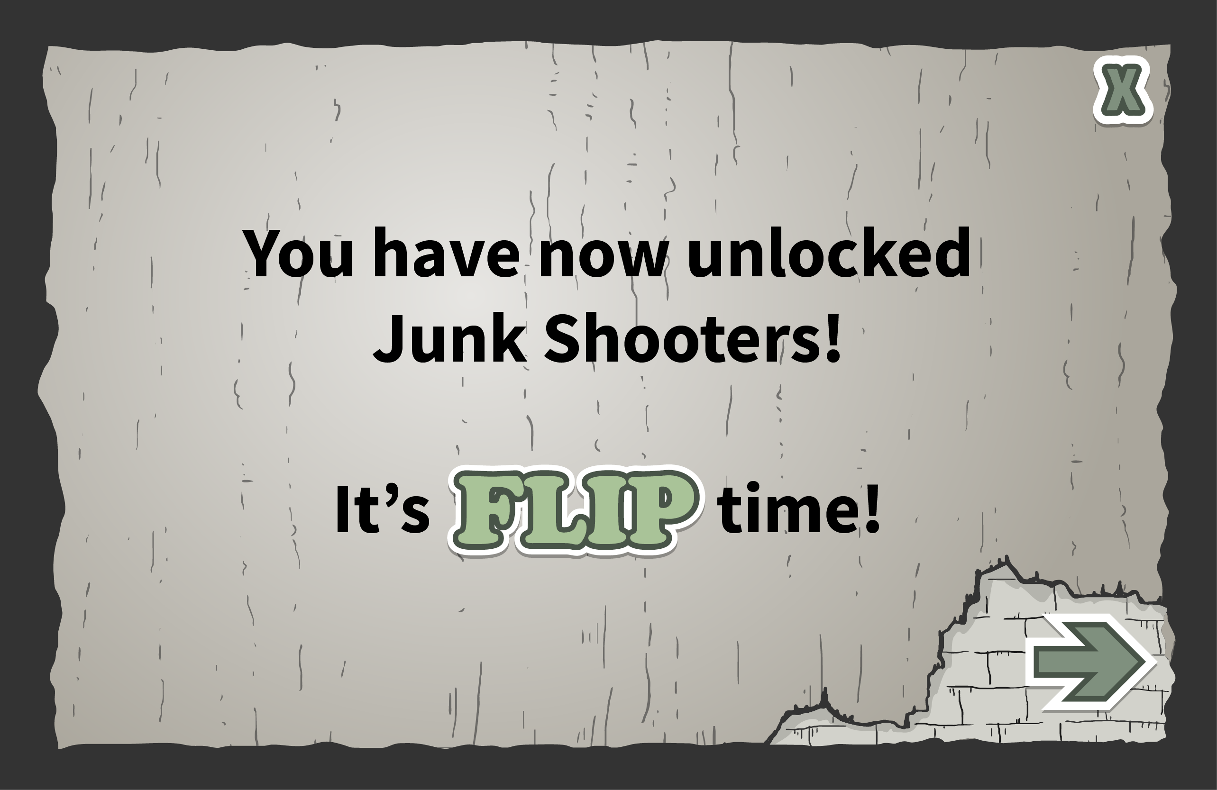

Slide 16
